Slide 1
Document Database
Volume, Variety, Velocity

Slide 2
Motivation
Train and tracks management
Sensors data processing
A set sensors are deployed to monitor train movement.
Acceleration, Position (GPS- x-y coordinates), Coupling between carriages.
Long train, 20+ carriages.
Data is collected for near-real time analysis as well as other analysis, such as railway tracks maintenance.

Slide 3
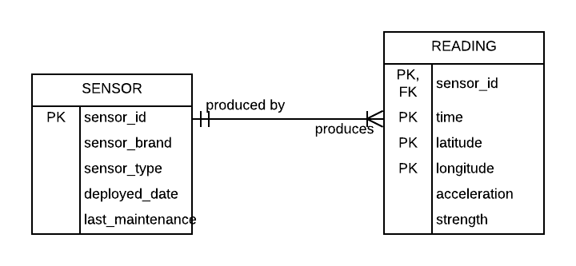
Motivation
Data Operation Characteristics
Sensor information does not change much.
Sensor readings:
Append/insert only operation, no update or deletion.
Large volume.
High velocity of insertion. (eg thousands records per minute).
Sensor configuration and what is being read may change overtime. i.e reading information may have different attributes set across time.

Slide 4
Potential issues when deployed in relational model.
Schema is not stable as sensors readings change.
Need flexibility or support of variety in data model.
To produce reports that combine SENSOR and READING information requires JOIN operation.
JOIN is an expensive database operation.

Slide 5
Document database
Popular name: NoSQL.
Examples: MongoDB, CouchDB.
Based on document data model.

